Slide 1
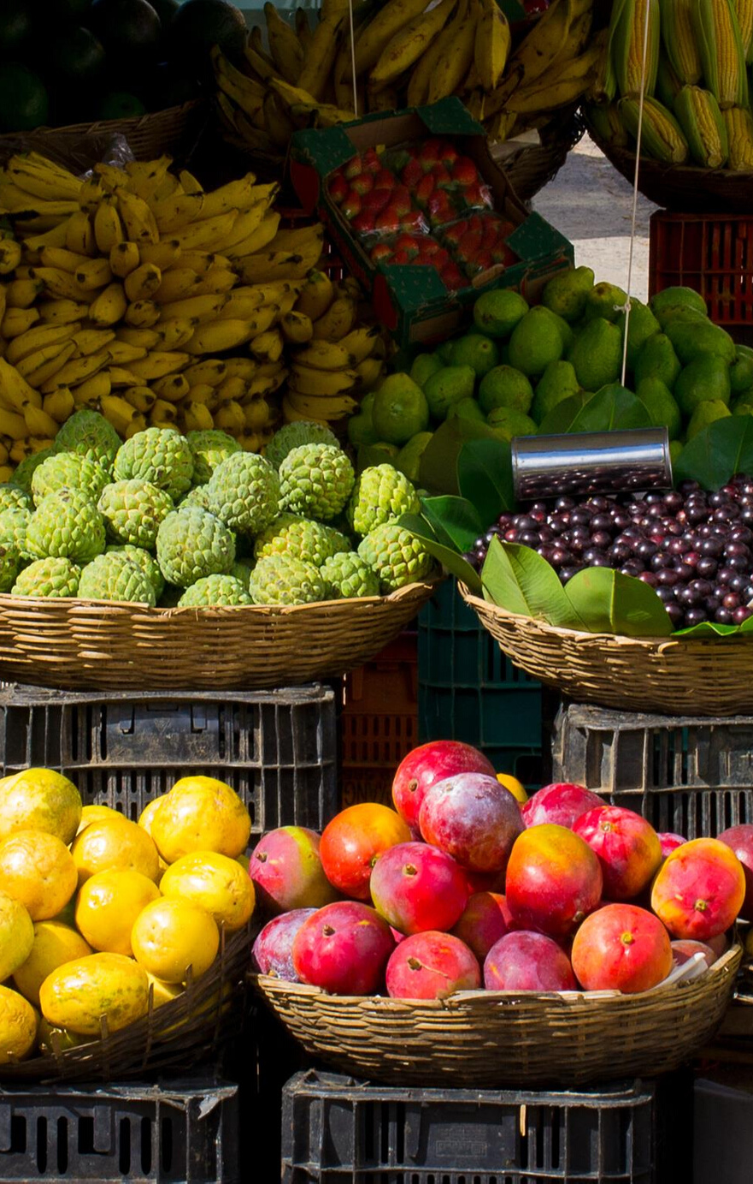
HACK THE MOUNTAINS 2.0
AGROLANCER
By:
Pratham Khandelwal,
Ayushman Mishra,
Uday Kahar,
Nouhaila Innan

Slide 2
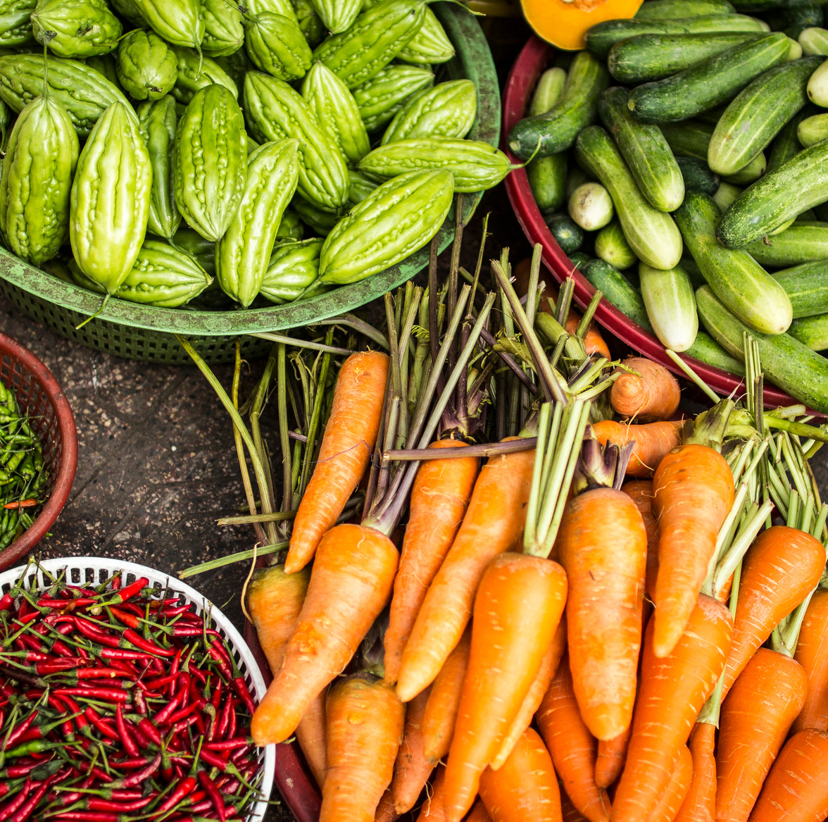
ABOUT AGROLANCER
AN INTRODUCTION
The idea is to create a website that facilitates the contact between the Farmers and the companies, each company will post on our site its needs of agricultural and citrus products.
Through this need we create a communicative link between the 2 correspondents: the farmers and the companies
And consequently the farmer will be able to make an exhibition of his product
Hack The Mountains 2.0

Slide 3





ABOUT OUR SERVICE
THINK HAPPY
Honest
Attentive
Passionate
Professional
Youthful
Hack The Mountains 2.0

Slide 4
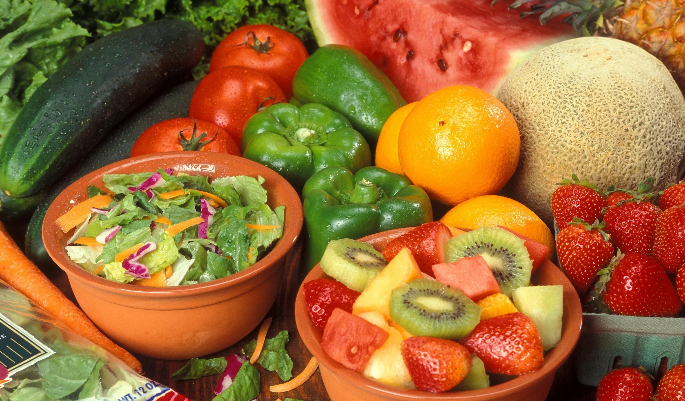
THE WEBSITE
WELCOME TO AGROLANCER
Hack The Mountains 2.0

Slide 5
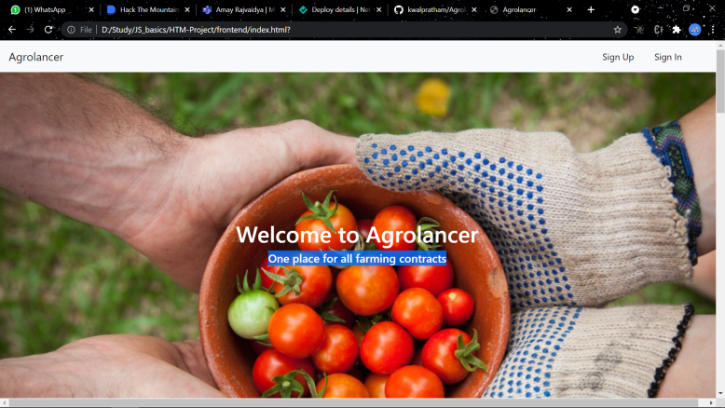
Hack The Mountains 2.0

Slide 6
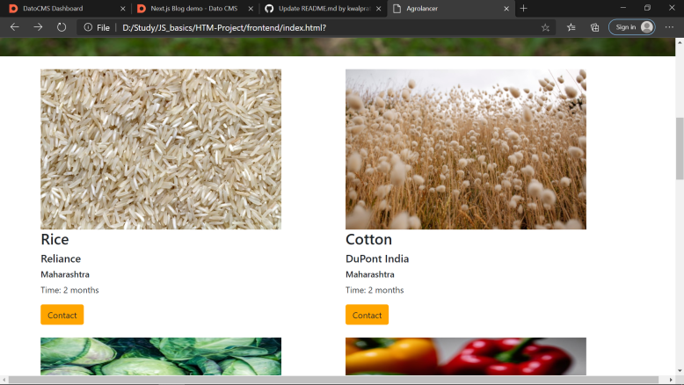
Hack The Mountains 2.0

Slide 7
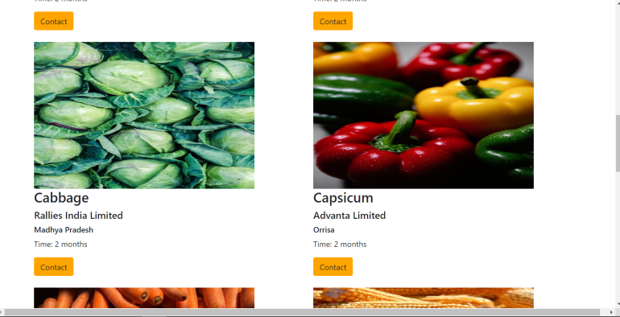
Hack The Mountains 2.0

Slide 8
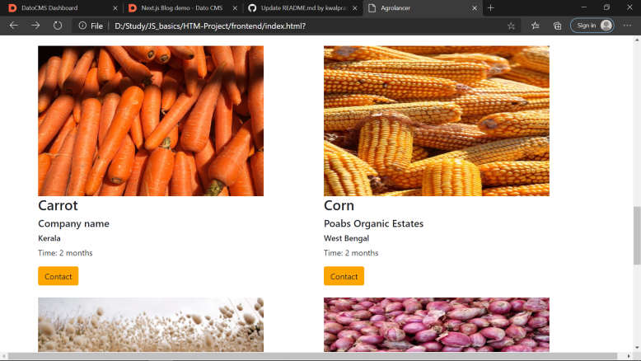
Hack The Mountains 2.0

Slide 9
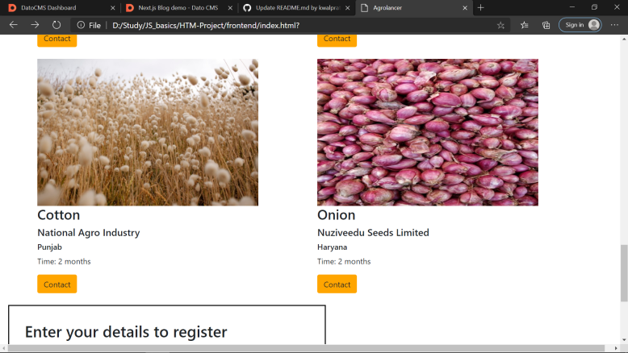
Hack The Mountains 2.0

Slide 10
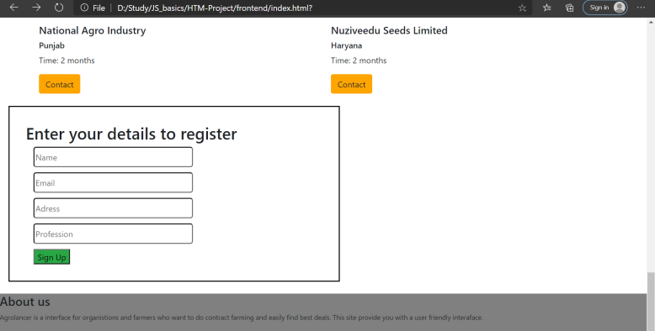
Hack The Mountains 2.0

Slide 11

FIND US HERE
SITE WEB
1W5WW
GITHUB
https://github.com/kwalpratham/Agrolancer
DEV FOLIO
WWW
Hack The Mountains 2.0

